Slide 1
1
Analysis and Support Services for Transport, Content, and Vocabulary Health IT Standards for Meaningful Use
FHIM Discussion
March 17th, 2014

Slide 2
Agenda
2
Brief overview of database/tool
Brief overview of standards roadmap
FHIM Discussion
Next steps/ Follow up

Slide 3
FHIM Discussion/ Questions
3
FHIM milestones
What are the milestone for FHIM in the next three years
FHIM adoption
What is the adoption into the industry
FHIM domains
FHIM domain status (ie. consolidated, retired) See next slide
Mapping standards to FHIM domains
Is there a reference document that a standards mapping exercise has been completed that we can leverage?

Slide 4
Draft of 2014-2017 Data Model Standards Roadmap
4
FHIR
DSTU R1
DSTU R2
Normative FHIR R1 (2016)
SDC REST/OAuth IG
QDM/ vMR alignment
CDA
DSTU R2.1
Normative CDA R2.1
CDA R3 (past 2016)
QI
(TACOMA)
CDA R2.1 Scope
US/EU CDA Exchange Template
Health Quality DAM Ballot comment resolution
Quality Logical Model
FHIR alignment
QDM –based HQMF
QDM
Hosted on Healthcare.gov
MU 2 Support
CIMI
Revised Ref Model
Lab Model
Patient MM Model
IHTSDO Licensing Agreement
UML Rep Approval
FHIM
Progress of Adoption/Maturity/Readiness
Milestones Key
Low
Low-Med
Med-High
High
Major Milestones
S&I Artifact
Deliverable
Ballot

Slide 5
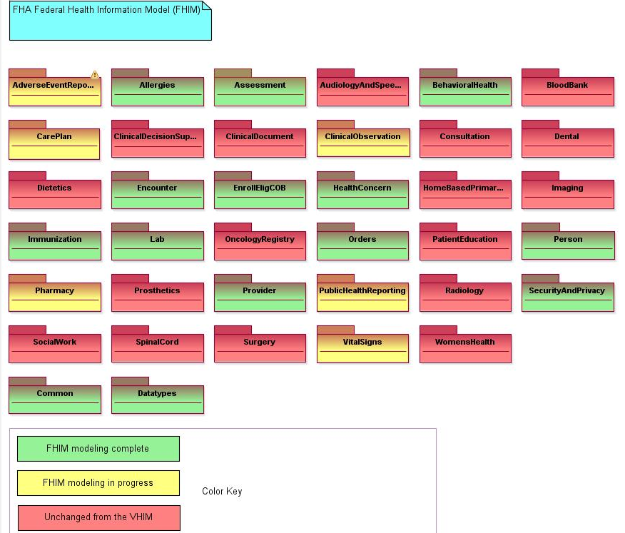
FHIM Discussion/ Questions
5
FHIM domains (37):

Slide 6
FHIM Discussion/ Questions
6
Mapping HIT Standards to FHIM domains:
Standard Abbreviation | Full Standard Name/Title | Classification | FHIM Domain | SDO Abbreviation
LOINC | Logical Observation Identifiers Names and Codes Database | Vocabulary/Codeset | Orders | Regenstrief
NCPDP Formulary and Benefit Standard | NCPDP Formulary and Benefit Standard | Content/Structure | Orders | NCPDP
DIRECT Messaging Specification | XDR and XDM for Direct Messaging Specification | Transport/Security | CDS | ONC
HITSP C32 | HITSP Summary Documents Using HL7 Continuity of Care Document (CCD) Component | Content/Structure | CDS | HITSP
Immunization Messaging | HL7 2.5.1 Implementation Guide for Immunization Messaging | Content/Structure | Immunizations | CDC

